Slide 1
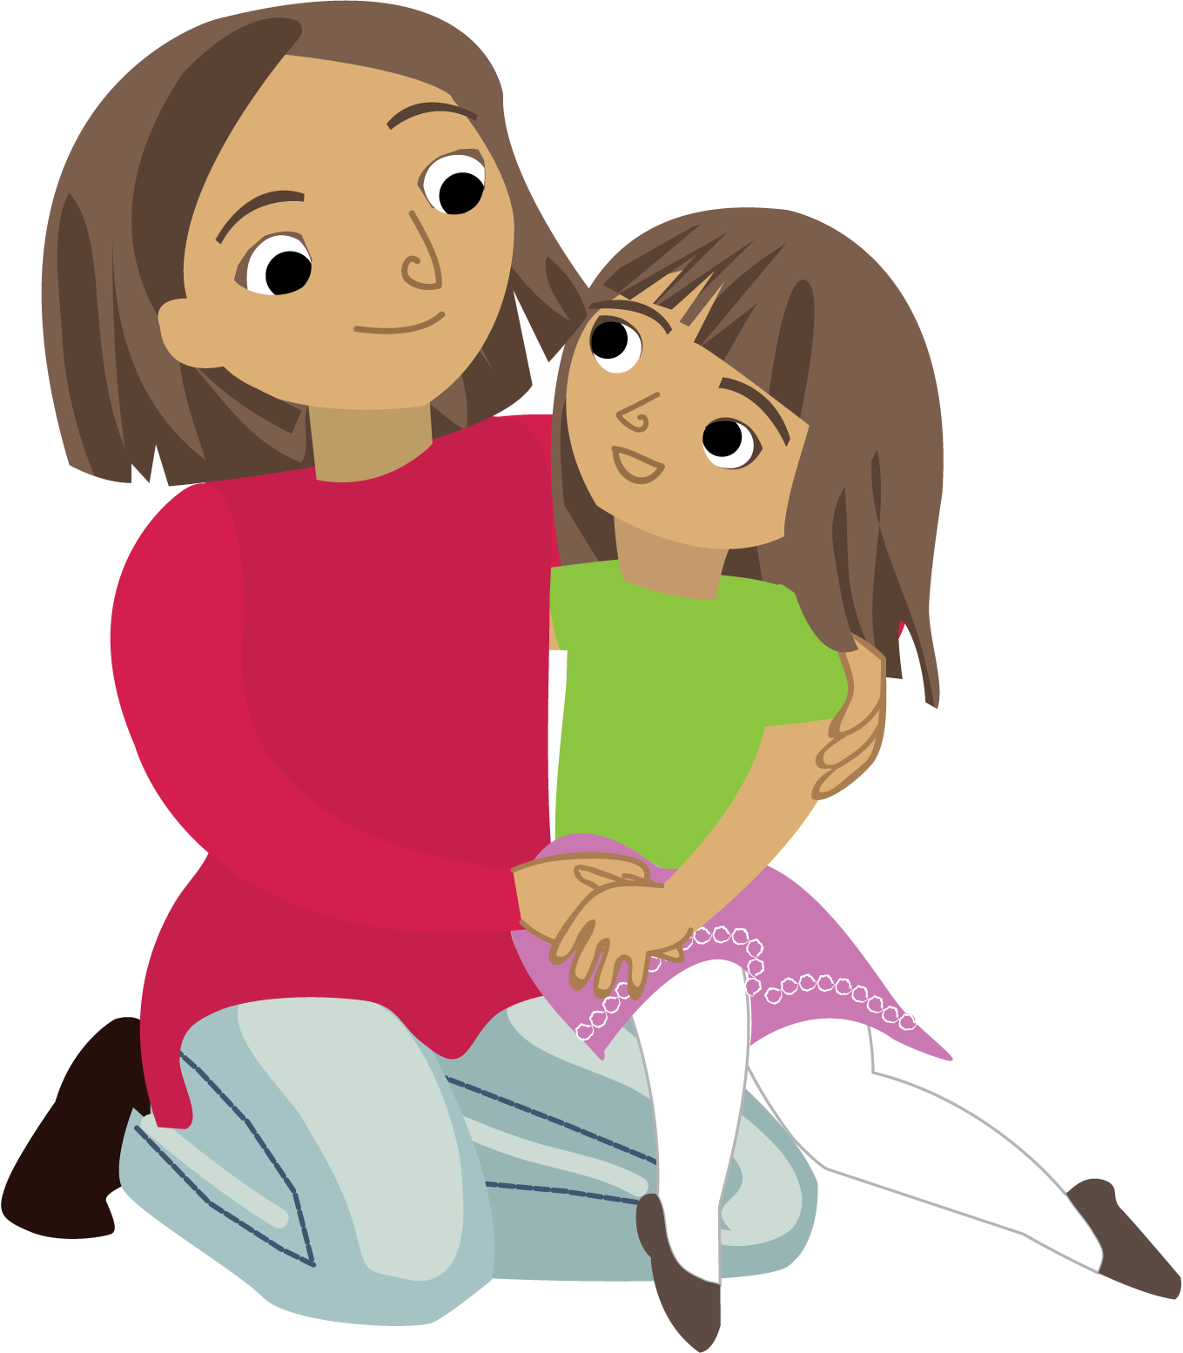
Learning without Limits!
Family Workshop
¡Aprendiendo sin límites!
Taller para padres
Notes:
Preparations for the presentation:
Have the Downloading Recommendations printed or available digitally for participants
Have the Getting Started Guide printed or available digitally for participants
Embed the “Change the first five years and you change everything” video into slide 2
If possible, have computer stations available for participants to access after the presentation to self-enroll
If possible, have wifi available for participants to download the app to their devices and download a few book titles and games to their device after they have self-enrolled
If you have participants that have children enrolled in schools, be prepared to provide them with their enrolled childrens’ super secret codes so that they can complete the self-enrollment process

Slide 2
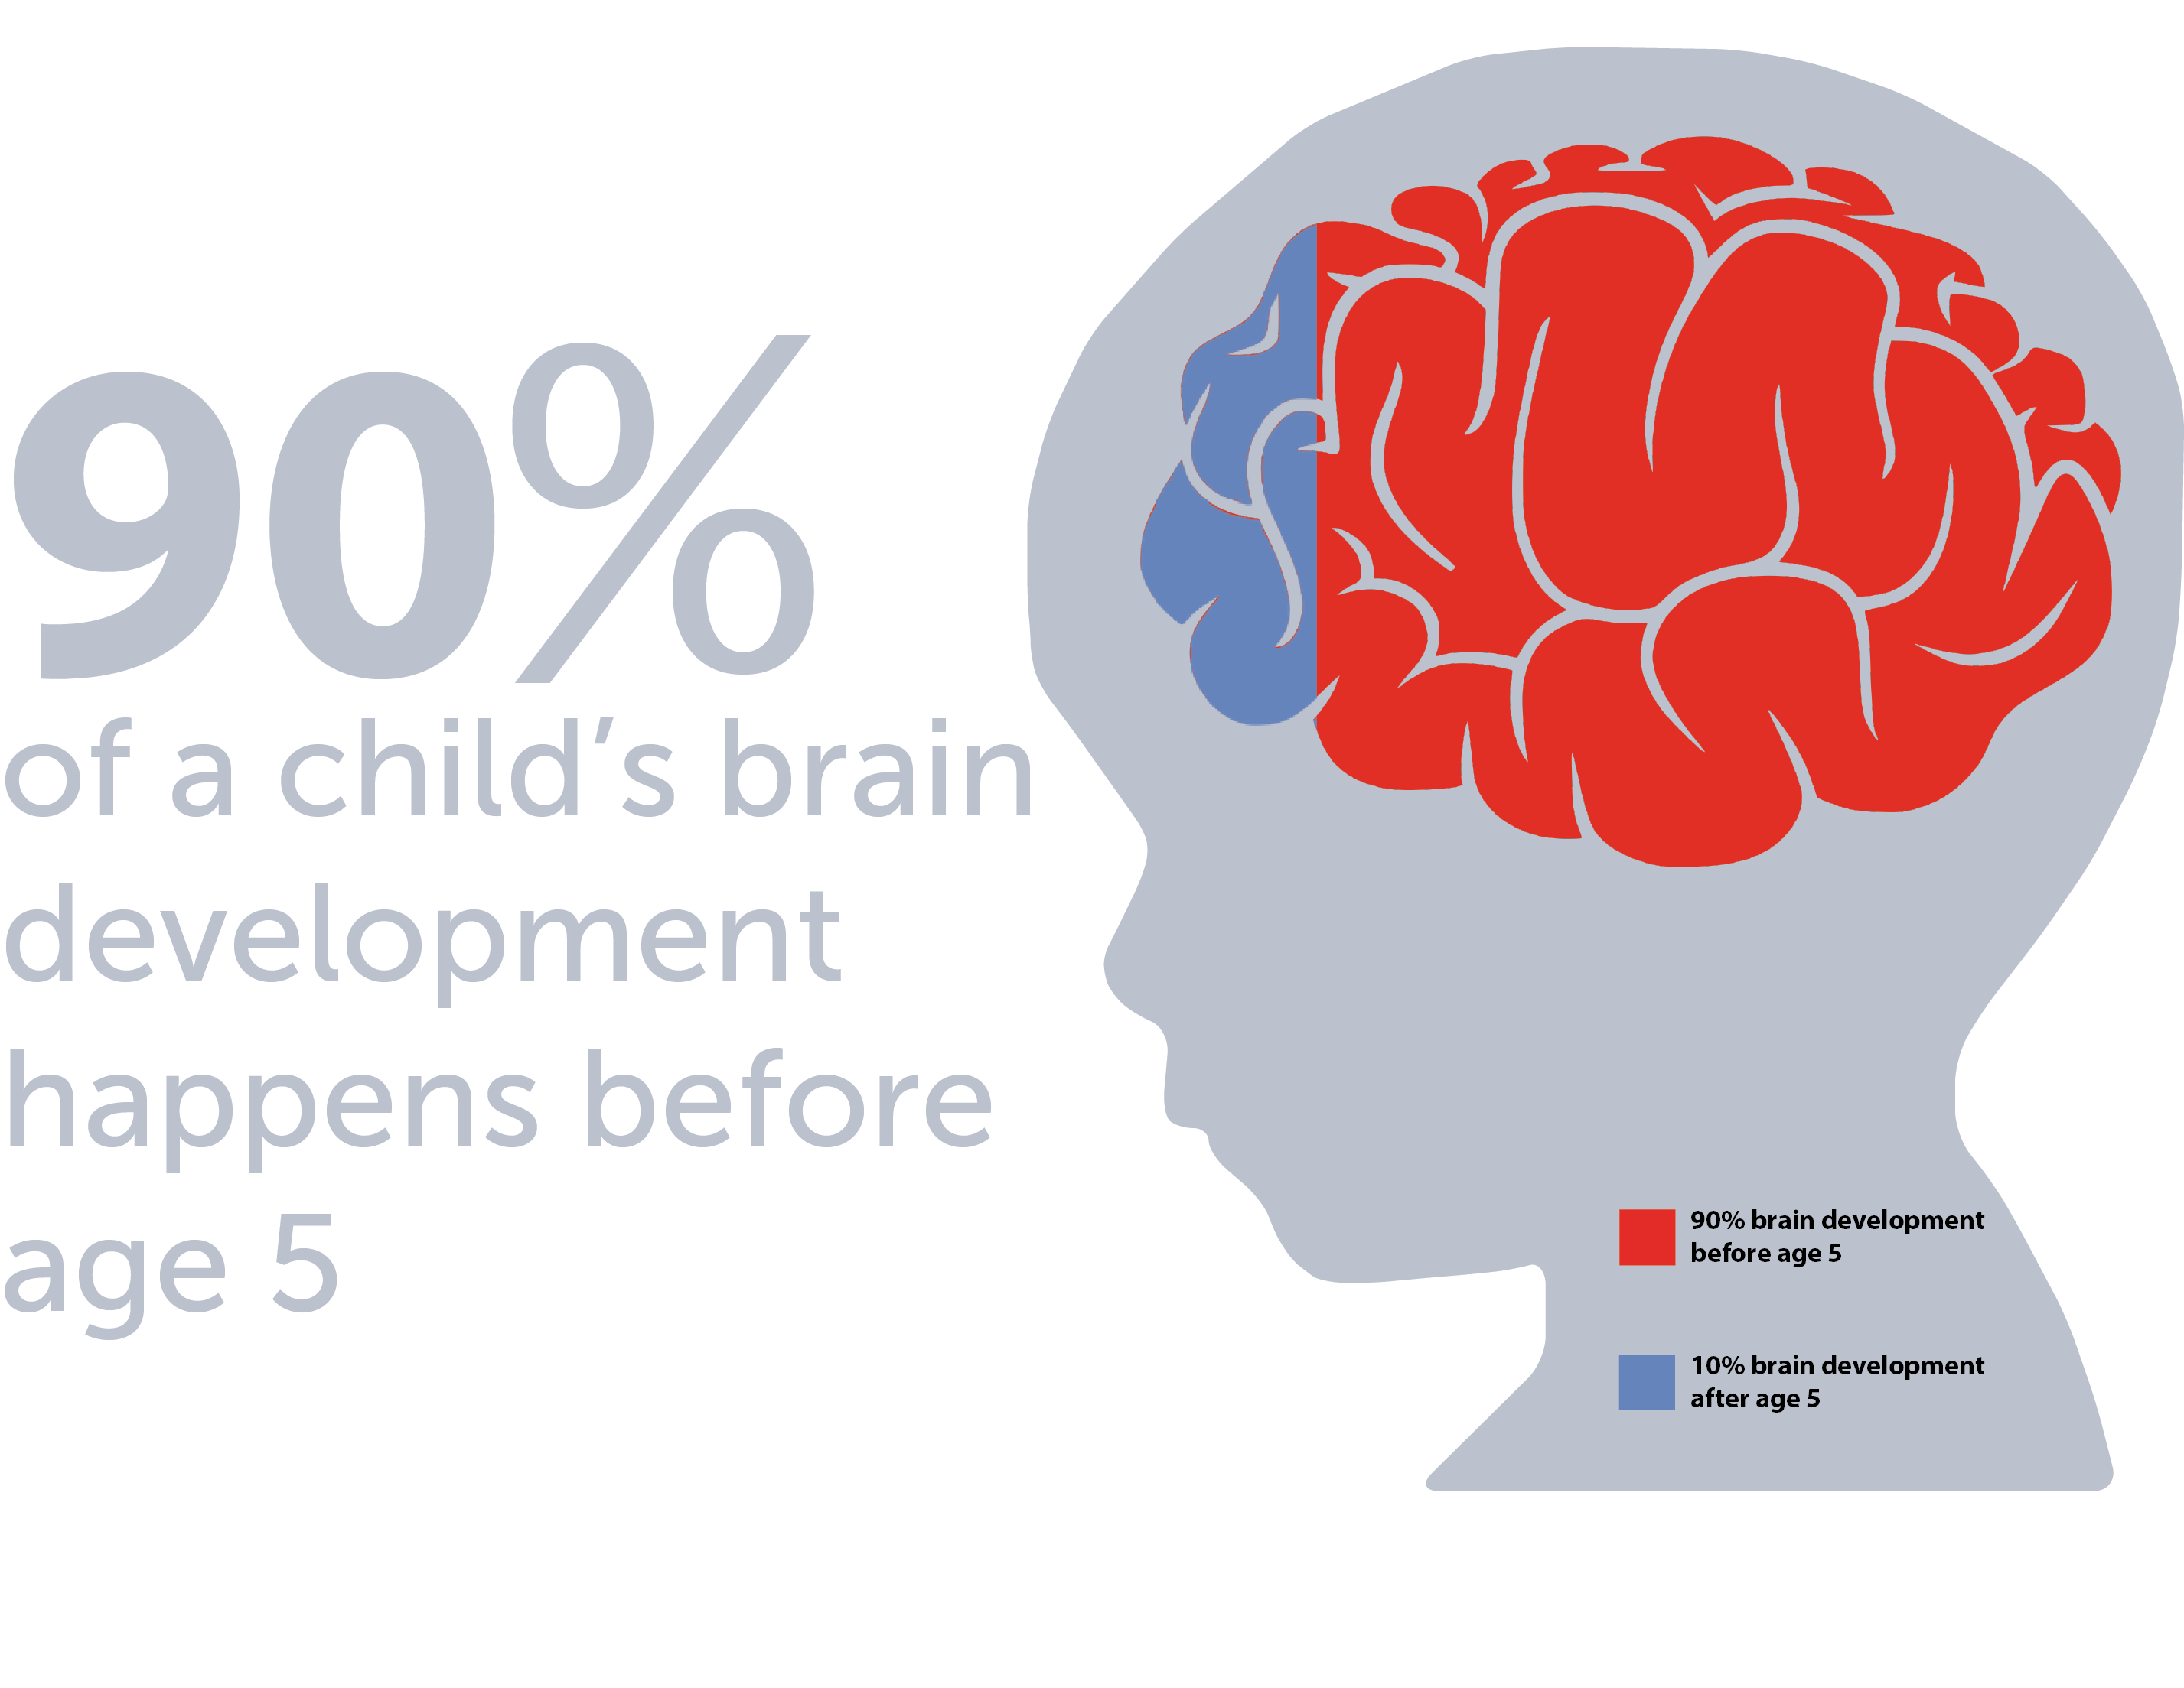

Why Spend Time on Literacy?
¿Por qué dedicarle tiempo a la lectura?
90% of a child’s brain development happens before age 5.
There is a strong connection to student achievement and literacy.
Spending 15 minutes a day on literacy strengthens a child’s brain!
El cerebro de su hijo se desarrolla un 90% antes de los 5 años.
Hay una conexión muy fuerte entre los logros de un estudiante y la lectura.
Dedicarle 15 minutos al día a la lectura fortalece el cerebro de los niños.

Slide 3



3 Learning Apps
3 Apps de aprendizaje
Clever Kids University™
Pre-Reader
Fun daily activities that prepare children for kindergarten.
Actividades divertidas diarias que preparan para el kínder.
Clever Kids University™
I Can Read
Fun daily activities that teach children to read and write.
Actividades divertidas diarias que le enseñan a su hijo a leer y a escribir.
Footsteps2Brilliance®
School Edition
Thousands of books and games to develop reading, writing, and critical thinking skills.
Cientos de libros y juegos para desarrollar la lectura, escritura y el pensamiento crítico.

Slide 4
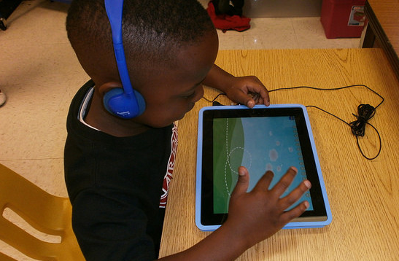
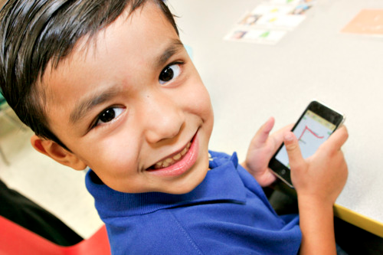
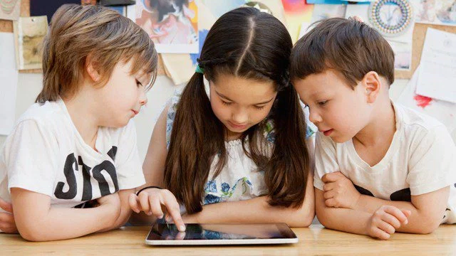
Who has Access? ¿Quién tiene acceso?
Students PreK – 3rd
Unenrolled children ages birth – 3rd grade
Parents of children ages birth – 3rd grade
District and school staff
Estudiantes de PreK – 3º
Niños no inscritos recién nacidos – 3er grado
Padres de niños recién nacidos – 3er grado
Personal del distrito y de la escuela
Notes:
Key talking points:
In developing our plan, the first question is “who?”
Through strategic partnerships, your district is able to provide this program for Free to families in our community ages birth through 3nd grad. This includes enrolled and unenrolled children and their families. Of course, district and school staff are given access. And this is a free service provided by the district and Footsteps2Brilliance to allow you to use the app for free.

Slide 5
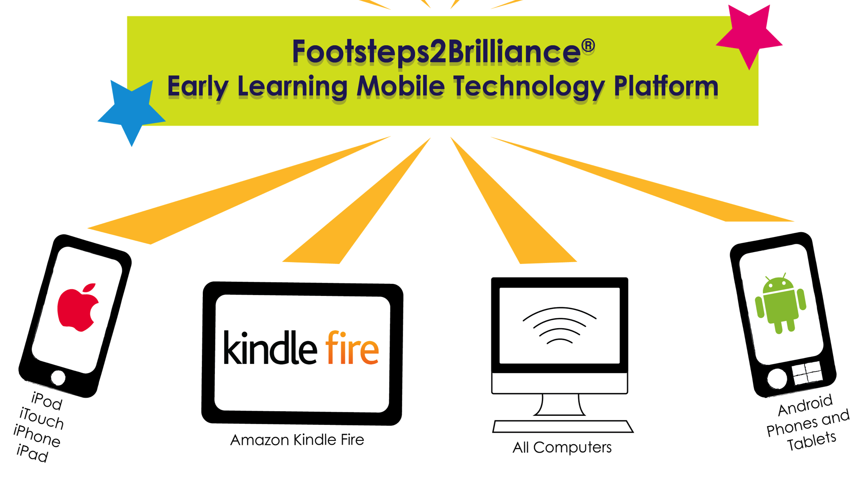
Works on any mobile device!
¡Funciona en todo dispositivo móvil!
Notes:
Talking points:
Footsteps2Brilliance works on any device. Because equity access is a key priority in the reaching every family and child and because we know most families own a smart device, Footsteps2Brilliance is developed so that it is supported on any device.

Slide 6


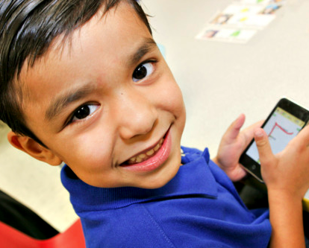

Where to access Footstep2Brilliance
Dónde acceder a Footstep2Brilliance
learning center
centros de aprendizaje
at school
en la escuela
on the go
en el camino
at home
en la casa
Notes:
Once you download the app you can use it anywhere to make it easier to ensure your child/children spend time reading everyday. Once downloaded the app does not require internet or wifi access, so you really can be anywhere and feel confident that your child will be able to fit in their reading everyday.

Slide 7

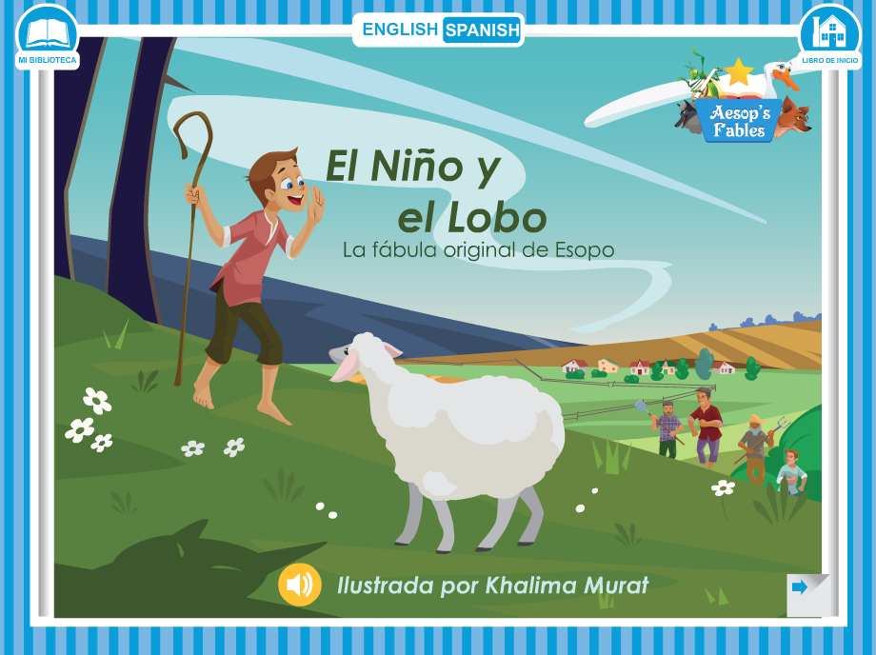
Supports Bilingual Language Development
Apoya el desarrollo del bilingüismo
Spanish
Español
English
Inglés
Notes:
Key talking points:
In the spirit of learning without boundaries, our App also completely supports bi-lingual language development in English and Spanish.
So parents are no longer left out of their child’s experiences because of their English language skills. The app makes it easy to switch between English and Spanish.

Slide 8

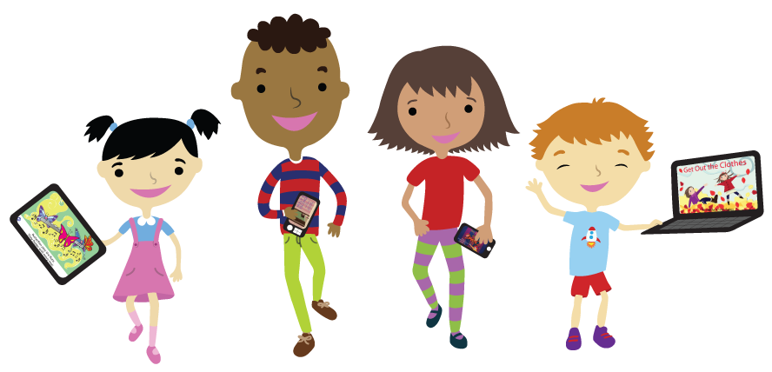
Internet Connection NOT Required
NO se requiere conexión al Internet
I do NOT need Internet to:
I need Internet to:
Get the App
Download Books & Games
Update the App
Report my progress
Play on the App anytime without Internet.
NO necesito internet para:
Jugar en la aplicación en cualquier momento sin Internet.
Necesito Internet para:
Obtener la aplicación
Descargar libros & juegos
Actualizar la aplicación
Informar sobre mi progreso
Notes:
The program is designed to work whether or not you have an internet connection! Let’s discuss when you need a connection and when you don’t.
You will an Internet connection to get started. We can use the Wi Fi here to get everything set up today.
You will need Internet to
Get the app
Download books & games
Update the app
Report my progress
Once you are set up, your child can play on the App without an Internet connection.

Slide 9

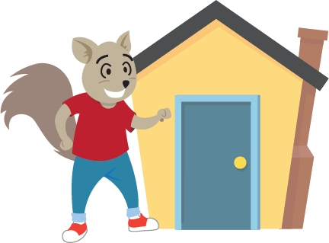
Connecting School to Home
Conectando la escuela con el hogar

Slide 10
Set a Routine for Daily Use
Mantenga una rutina para el uso diario
15 mins 5 days a week
Same time each day
Short sessions best for growth
5 días a la semana por 15 minutos
A la misma hora cada día
Las sesiones cortas son mejores para el desarrollo
15 mins 5 days a week
5 días a la semana por 15 minutos

Slide 11
Create Positive Practices
Fomente prácticas positivas
Talk with child
Hable con los niños
Help with sounds and letters
Ayúdelos con los sonidos y las sílabas
Talk about books
Hábleles de los libros
Read with child
Lea con los niños
Ask questions about what is read
Haga preguntas de lo que han leído
Source: National Center on Improving Literacy https://improvingliteracy.org
Notes:
Preparing Your Child to Read
TALKING WITH YOUR CHILD Helps your child
Learn about letters and letter sounds
Learn new words and ideas
Practice hearing and saying words
Practice talking back and forth
HELP YOUR CHILD WITH SPEECH SOUNDS AND LETTERS Helps your child
Hear how language works
Learn that letters relate to spoken sounds
Link letters to their sounds
Read words later
TALK ABOUT BOOKS WITH YOUR CHILD Helps your child
See that pictures stand for real things
Learn that print tells a story
Find new ways to say things
Learn new words
READING WITH YOUR CHILD helps your child
Learn new sounds, words and ideas
Link letters to their sounds
Learn how books work
Develop an interest in reading
ASKING QUESTIONS WHEN TALKING ABOUT OR READING BOOKS Helps your child
Think in new ways
Consider new words and ideas
Explain her thinking
Make sense of letters, sounds and words

Slide 12
Asking Questions - CROWD
Hacer preguntas
Completion (Completar)
Wh Prompts (Interrogativas)
Distancing (Descontextualizar)
Recall (Recordar)
Open-ended (Abiertas)
Source: National Center on Improving Literacy https://improvingliteracy.org/
Notes:
CROWD helps you remember different kinds of questions to ask
Completion Ask your child to fill in the blank using words from the story after it is repeated several times or once it is very familiar.
For example: “And the caterpillar turned into a beautiful ______________.”
Recall Ask your child to tell you what happened in the story. For example: “Can you tell me two foods the caterpillar ate?”
Open-ended Ask your child what is happening in a picture or story to get her talking. For example: “Tell me about the caterpillar.” “Why do you think the caterpillar was so hungry?”
Wh prompts Ask your child who, what, when, where, and why questions. For example: “Can you tell me two foods the caterpillar ate?” “When does a caterpillar turn into a butterfly?” “Why do you need to eat?”
Distancing Ask your child to connect to something in her own life. For example: “What do you think would happen if you ate that much?”

Slide 13
Support Your Child’s Literacy
LISTEN
ESCUCHE
LOOK
MIRE
Apoye la alfabetización de sus niños
HELP
AYUDE
ENCOURAGE
ANIME
Source: National Center on Improving Literacy https://improvingliteracy.org/
Notes:
4 key ways to support your child’s literacy development
LISTEN and note which sounds, letters, words, or ideas seem hard for your child when reading aloud or talking.
LOOK and watch for the skills or tasks that appear difficult for your child. See if they improve with practice.
HELP by pausing and giving your child a chance to correct a mistake. Then try giving her a hint or prompt to figure it out.
ENCOURAGE by talking with your child about the book or activity. Offer praise when successful and reassure him when difficulties arise

Slide 14




Follow the Stars
Siga las estrellas
Read Book
Leer el Libro
Play Book Buddies
Amiguitos de Librito
Play Games
Juegos
Help Child Create-a-Book
Ayúdelos a Crear un Libro

Slide 15
How to Read a Footsteps2Brilliance Book
Cómo leer un libro en Footsteps2Brilliance
Click Speaker
Presione el altavoz
Record
Grabe
Touch Words
Presione las palabras
Click on Pictures
Presione las imágenes
Click ENG / ESP Toggle Button
Presione el botón ENG/ESP
Notes:
Click purple speaker on each page and sing or read along.
Click red microphone to record child singing or reading along. Develops speaking skills.
Read in child’s first language to help transition to English. Click the ENG/ESP toggle button to switch the language. Have your child repeat the words in each language.
Touch the words and have child repeat the word.
Click on the pictures and have child repeat the word or talk about the picture.
As you read, have the child fill-in the rhyming words or complete sentences
Ask child to point to common sight words like a, is, the, and, you, and to.

Slide 16
Parent Registration
Registro para las familias
Create parent account and connect to student/s. Add unenrolled children.
Cree una cuenta principal y vincúlela con la de sus estudiantes. Registre a los niños no inscritos.
Go To / Ir a :
myf2b.com/register/[add you district link]
Notes:
Participants should go to the URL on the screen and enroll.
Support individuals as needed.
Once everyone has gotten to the URL, move forward to the next screen so they know what to do next.

Slide 17
Tips for Parent Enrollment
Things to know …
Lo que debes saber…
No personal information is shared.
Usernames, passwords, and Super Secret Codes are sent to the parent’s email.
No se comparte información personal.
Los nombres de usuarios, contraseñas y Códigos Súper Secretos se envían al correo electrónico de los padres.
Notes:
Ensure participants that NO personal information is ever shared ever! We do not want people to be concerned that if they share their information that somehow the schools, district, or Footsteps2Brilliance will be viewing, using or sharing their information. The sole purpose of gathering the information is to ensure that they are residents of the Fitchburg area, only.
One critical key is that when they self-enroll unenrolled children is that they need to use the name on the child’s birth certificate exactly as this will ensure that when the child eventually enrolls in school, we can move them from the community into the schools for reporting purposes. Their data will follow them.

Slide 18



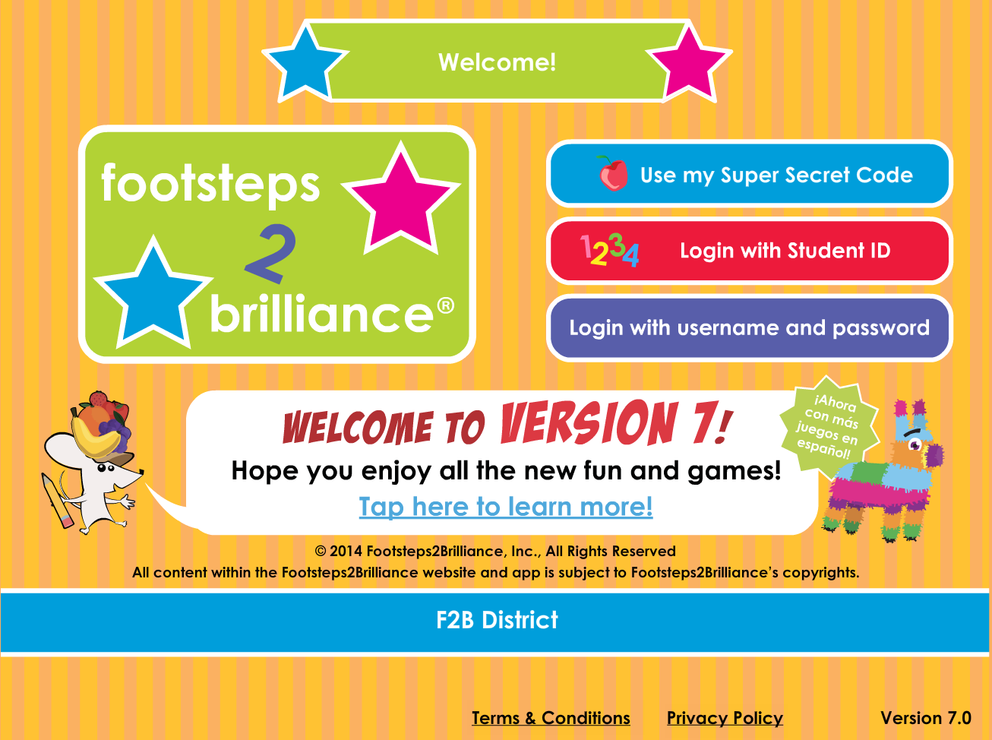


How to Access
Cómo acceder
or/o
Web
Go To / Ir a
www.myf2b.com
FREE App / App GRATIS
Search for / Buscar
Clever Kids University or Footsteps2Brilliance
Notes:
There are two different ways to access Footsteps2Brilliance. 1 – parents and children alike can access Footsteps2Brilliance from any computer browser that has internet access. 2 – OR Footsteps2Brilliance can be accessed by downloading the app to your device. After downloading the app and content, you can access the app anywhere, anytime with or without internet or wifi access. A unique feature of the program is that regardless of how or where you access it, the experience is the same. This highly unique and not typical of other apps.

Slide 19
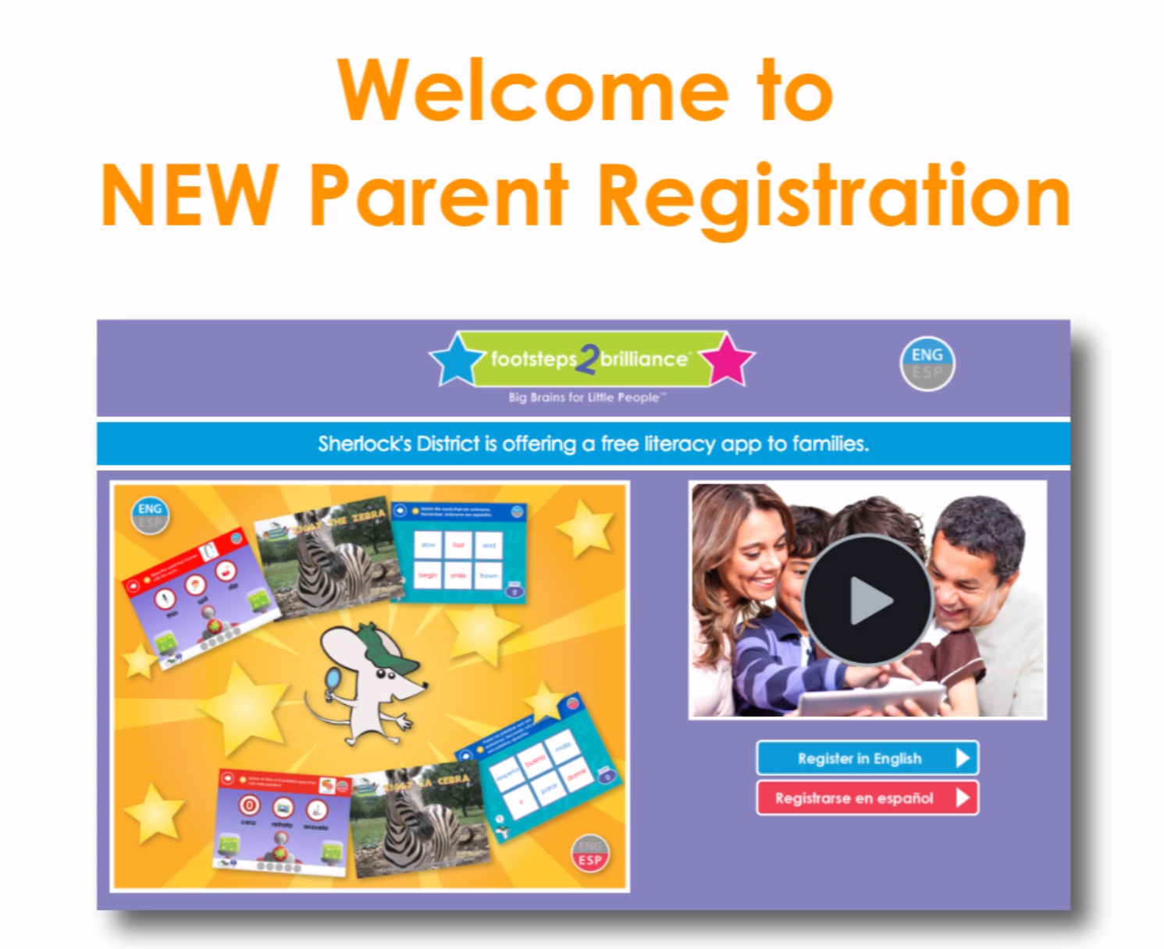
Parent Registration Demo
Registro para las familias

Slide 20

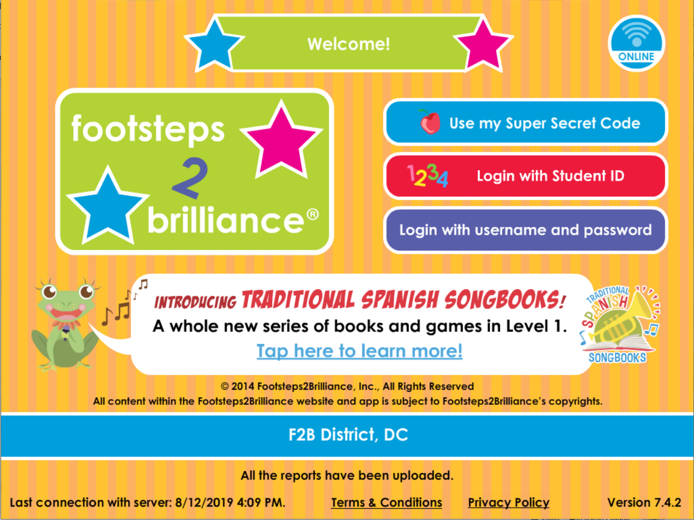
Time to Log In
Hora de iniciar sesión
Notes:
Parent login experience…parents should not play on their child’s account, but log in as themselves to explore the system and access their child/rens data.

Slide 21
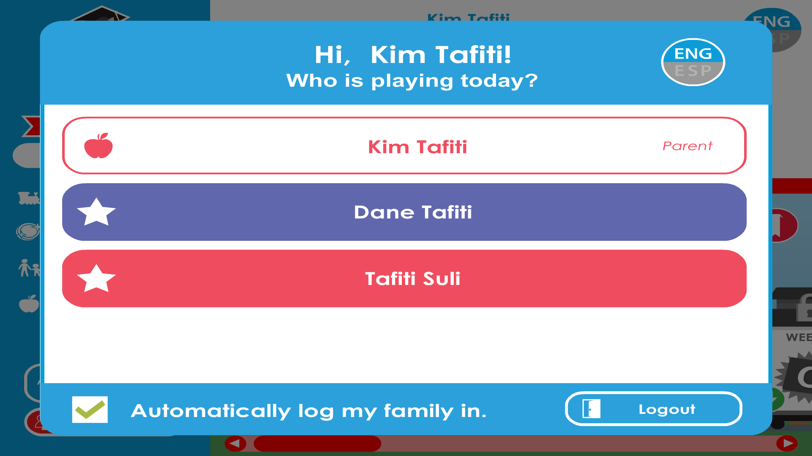
Parent Login
Inicio de sesión para las familias
Parent Tip: Login First and check box to stay logged in
Consejo: primero inicie sesión y marque la casilla para mantenerse conectado

Slide 22








The App is like a container.
Now you need to download the books, songs, and games you want to use.
La aplicación es como un recipiente.
Ahora necesita descargar los libros, canciones y juegos que desea usar.
You can add and remove content at anytime, so that the App doesn’t get too big on your device.
Puede agregar y eliminar contenido en cualquier momento para que la aplicación no sea demasiado grande en su dispositivo.
Notes:
Once parents download the app, they must download the desired content. We have provided downloading recommendations to assist parents with this process. Pass this document out now or provide it to participants digitally.

Slide 23
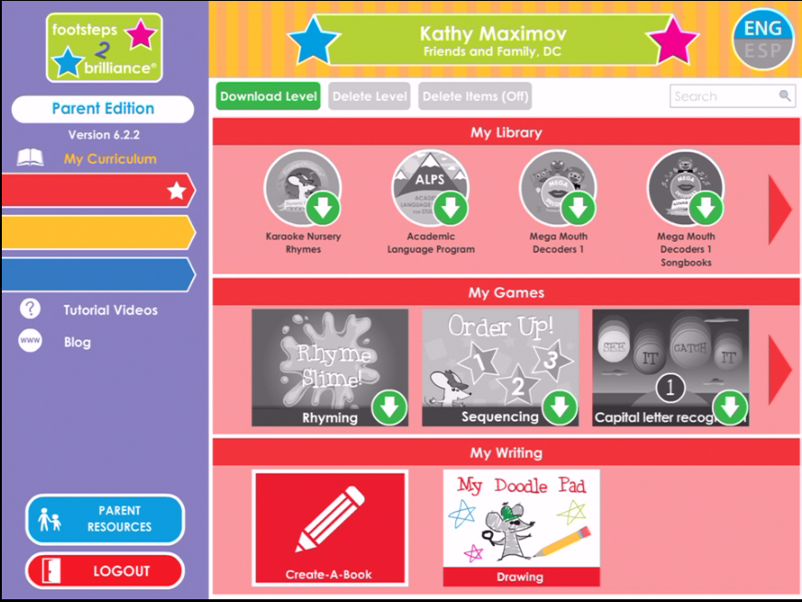
Tips for Managing Content
Consejos para administrar el contenido
This will download the entire level.
Esto descargará el nivel complete.
This will download a series of books.
Esto descargará una serie de libros
This will delete content for the entire level.
Esto eliminará el contenido del nivel completo.
This will download a series of games.
Esto descargará una serie de juegos.
This will turn on the buttons to delete content.
Esto activará los botones para eliminar el contenido.
Notes:
This is how parents will manage the content in the app on their device. They must be logged in as themselves to be able to delete content from the device.

Slide 24
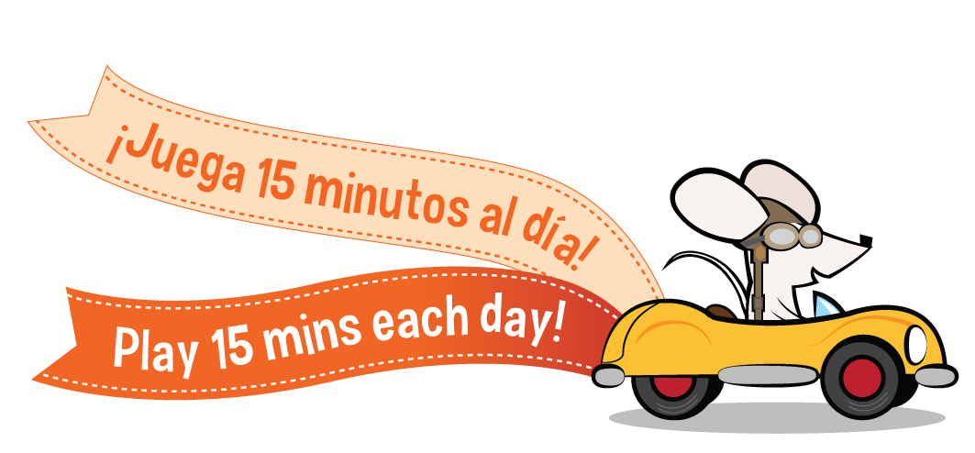
Goal Attained!
¡Objetivo alcanzado!

